Slide 1

IA, Wireframing & Prototyping

Slide 2

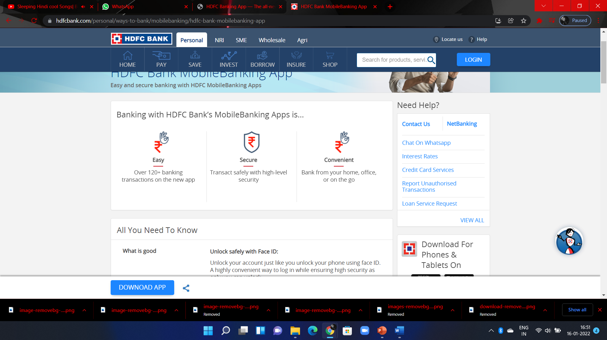
EASY
SECURE
CONVENIENT
ABOUT
HDFC Bank Mobile Banking App lets you track all your financial expenses in one place.
Banking with HDFC Bank’s Mobile Banking Apps is…
Transact safely with high-level security
Over 120+ banking transactions on the new app
Bank from your home, office, or on the go

Slide 3



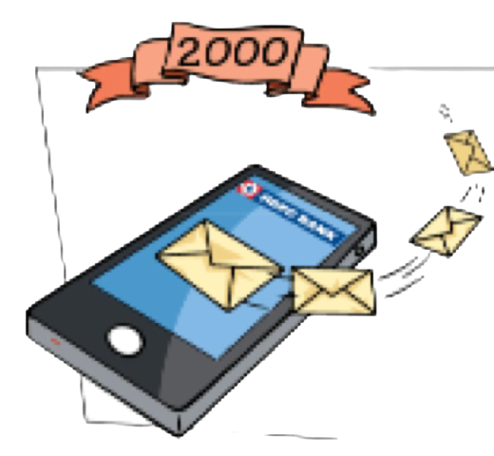

HDFC EVOLUTION
New logo launched
1997
1999
Launched real time online net banking , also launched the 1st debit card in India
Launched 1st SMS based mobile banking
2000
2010
Launched 40% faster ATM’s

Slide 4
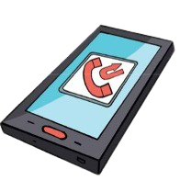



HDFC EVOLUTION
Launched missed call banking
2013
2014
Mobile/ net banking have the largest number of transactions
Launched its anthem - MOGO
2015
2016
Launched Chillr and Payzapp
Launched missed call mobile recharge service

Slide 5

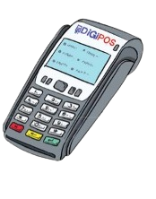

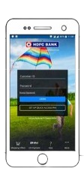
HDFC EVOLUTION
IRA Launched
EVA Chatbot Introduced
2017
2018
Boosting digital payments with DIGIPOS
IRA 2.0 launched
EVA integrated with Amazon ALEXA , Google assistant
2019
2020
Next Gen mobile banking app launched
Best digital bank in india

Slide 6

MARKET RESEARCH

Slide 7

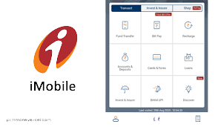


IMOBILE PAY
TOP COMPETITORS
PNB ONE
AXIS MOBILE

Slide 8
WEAKNESESS OVER IMOBILE
TRANSFER OF FUNDS
APPLYING FOR NEW ACCOUNTS
INSTA-ALERT CUSTOMISATION
MORE LIMITATIONS

Slide 9
OPPORTUNITIES OVER IMOBILE
TDS ENQUIRY FACILITY
RE-GENERATION OF IPIN
THE USER INTERFACE & EASE TO USE
SECURITY FEATURES

Slide 10

TECHNOLOGY USED
ARTIFICAL INTELLIGENCE
VIRTUAL RELATIONSHIP MANAGER
GOOGLE FONT API

Slide 11
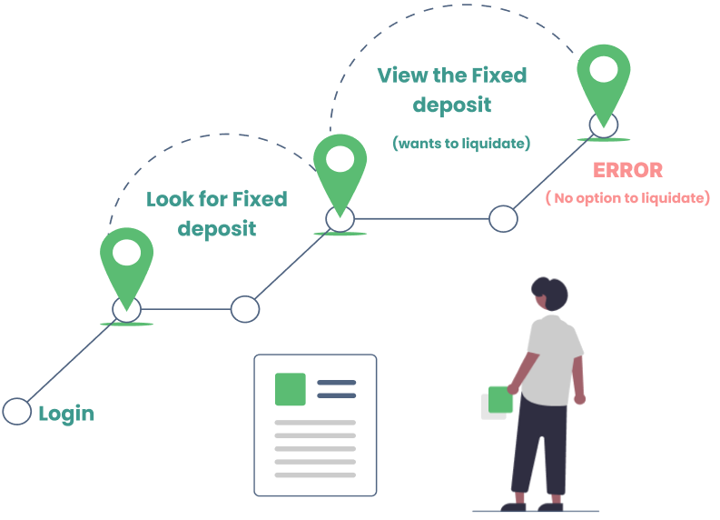
A Short Example

Slide 12
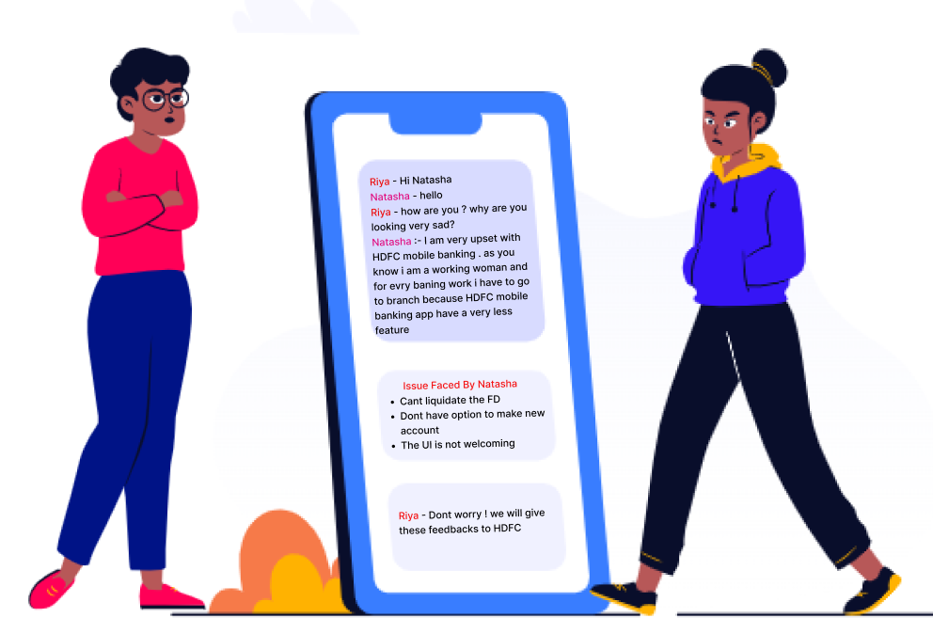

Slide 13

WHAT DO WE DO ? SUGESSTIONS
01
03
02
04
UI of the app should be more welcoming
Personalized and customized banking
More facilities and services offered
Bill pay charges should be less or free

Slide 14
SOLUTIONS!

Slide 15
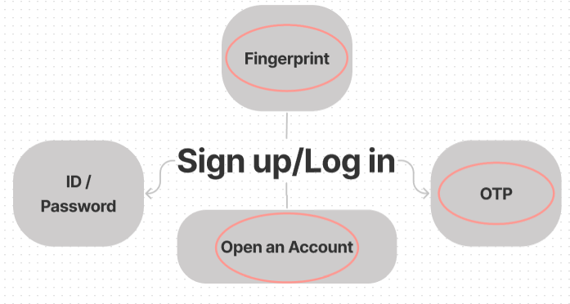
INFORMATION ARCHITECTURE
*Words in Red circle are the new features which we suggest*

Slide 16
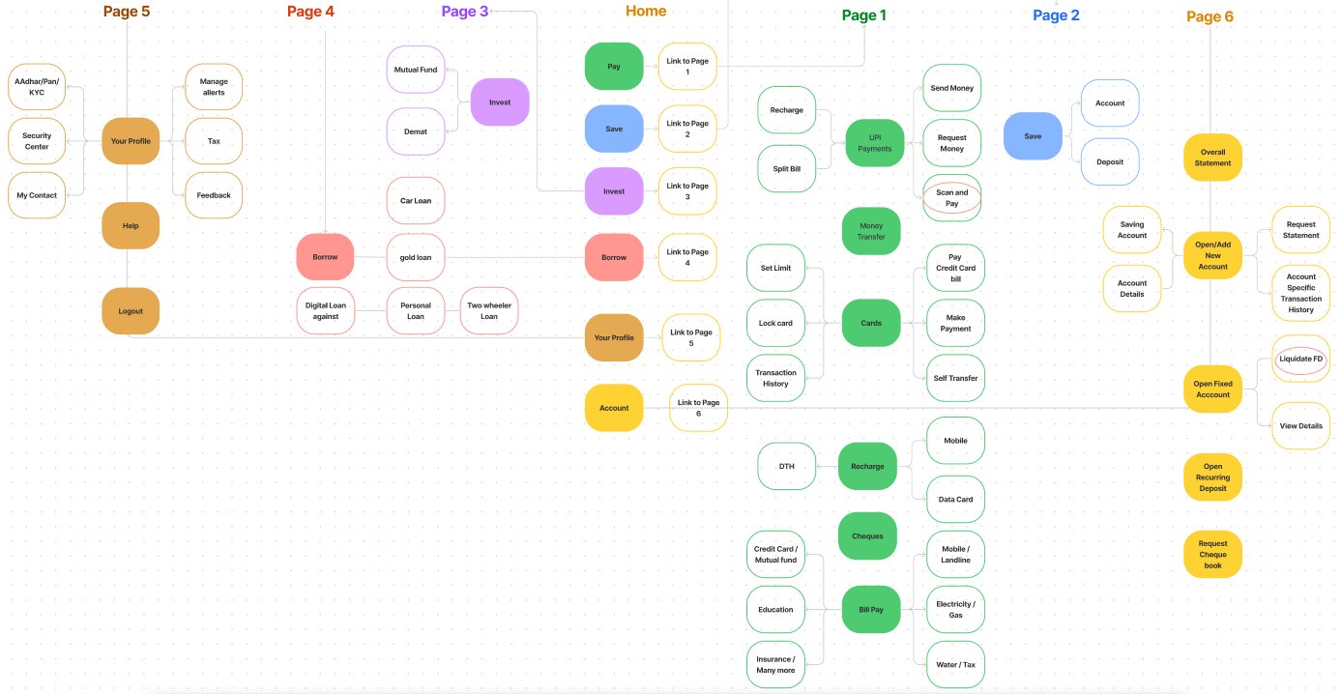

Slide 17
UPDATED WIREFRAMES!
*Low Fidelity , High Fidelity , Paper wireframes*

Slide 18
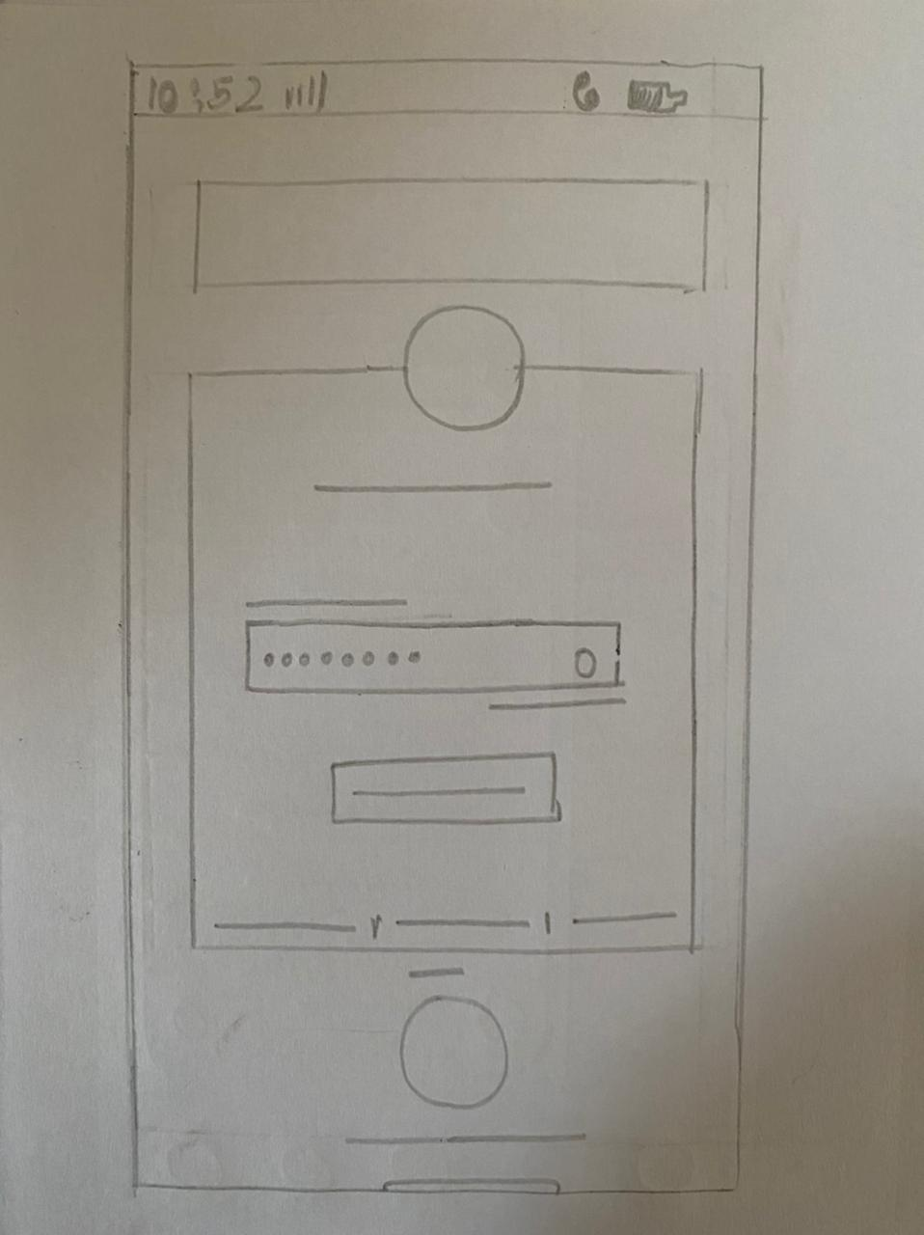
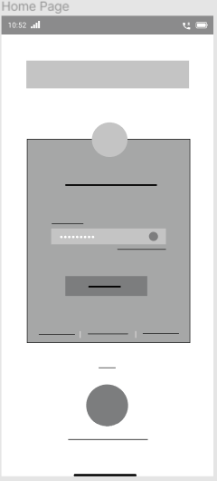
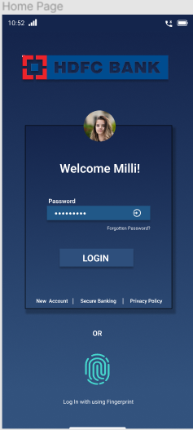
SCREEN 1

Slide 19
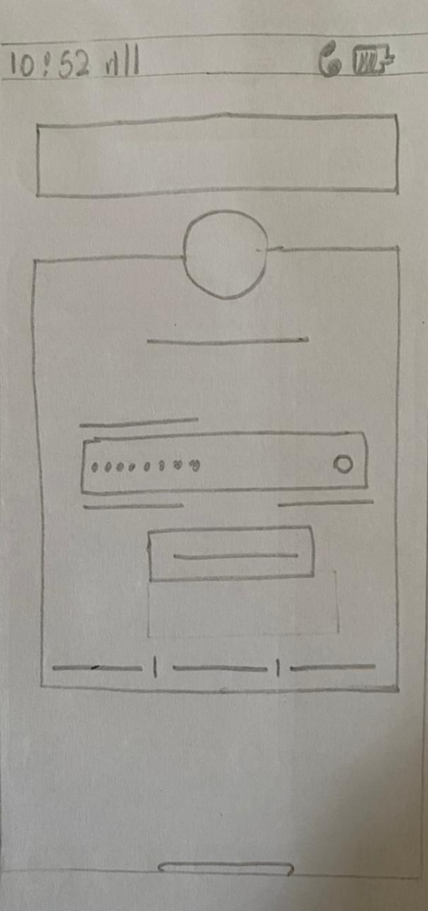
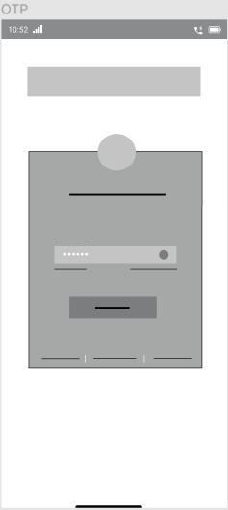
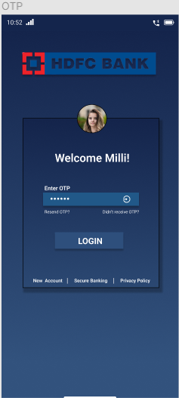
SCREEN 2

Slide 20
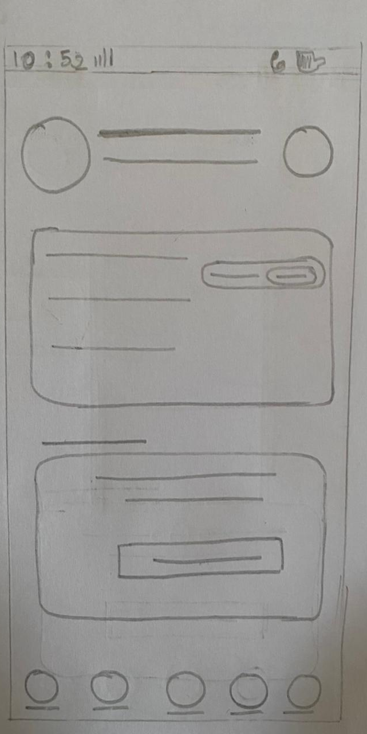
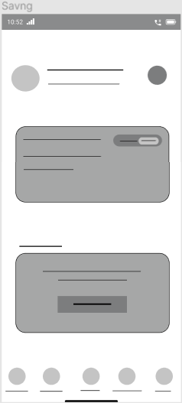
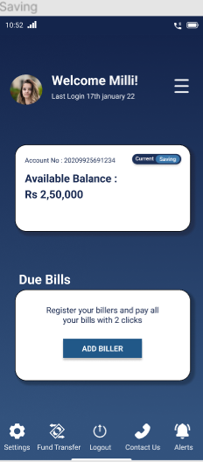
SCREEN 3

Slide 21
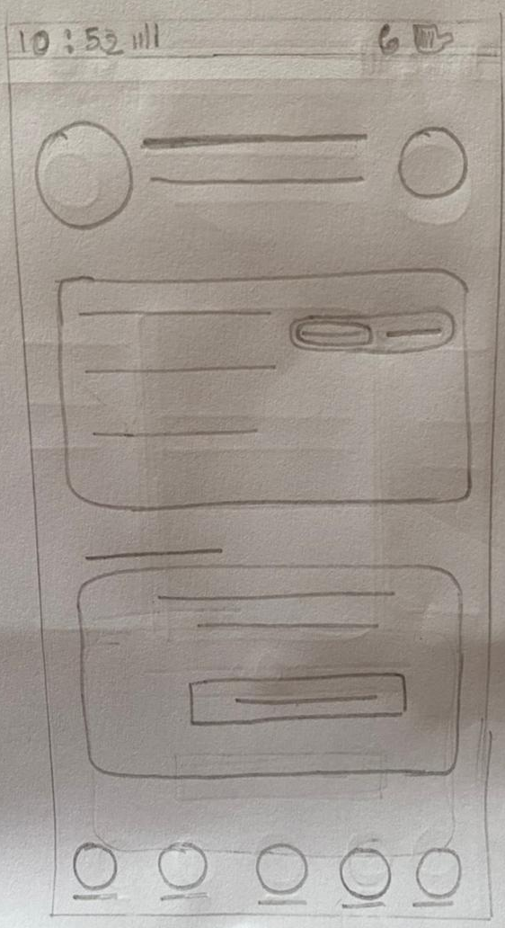
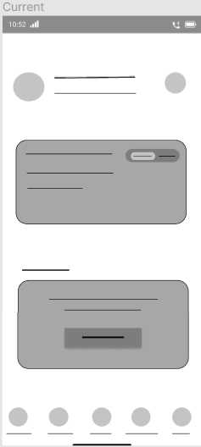
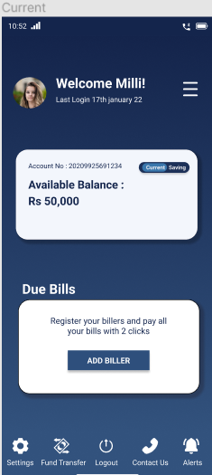
SCREEN 4

Slide 22
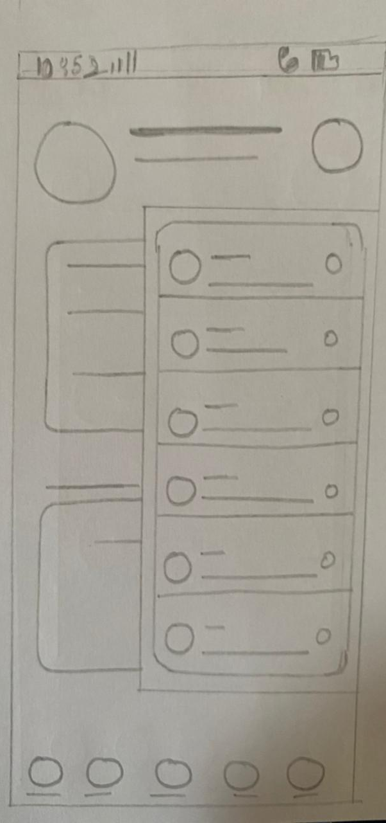
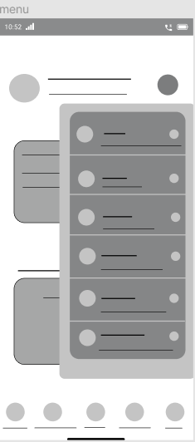
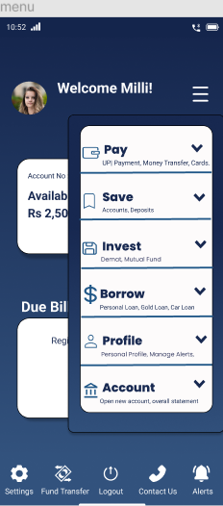
SCREEN 5

Slide 23
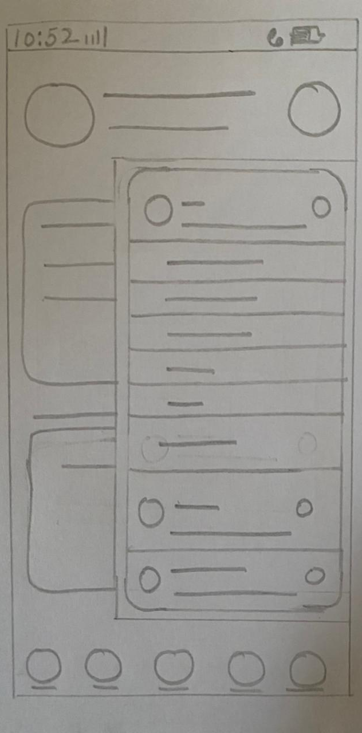
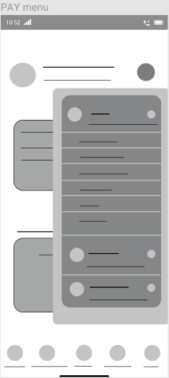
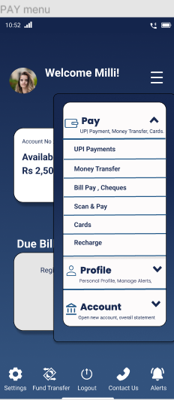
SCREEN 6

Slide 24
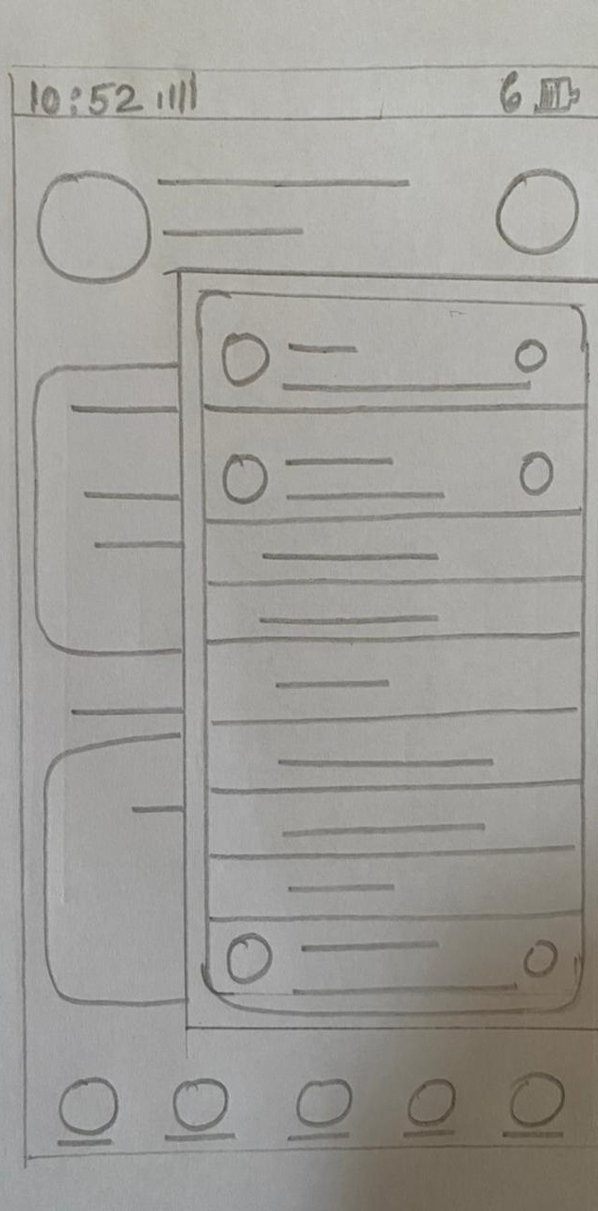
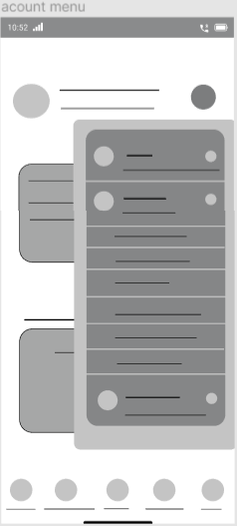
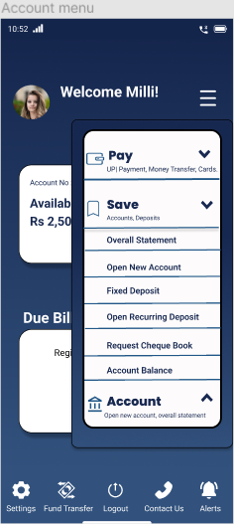
SCREEN 7

Slide 25
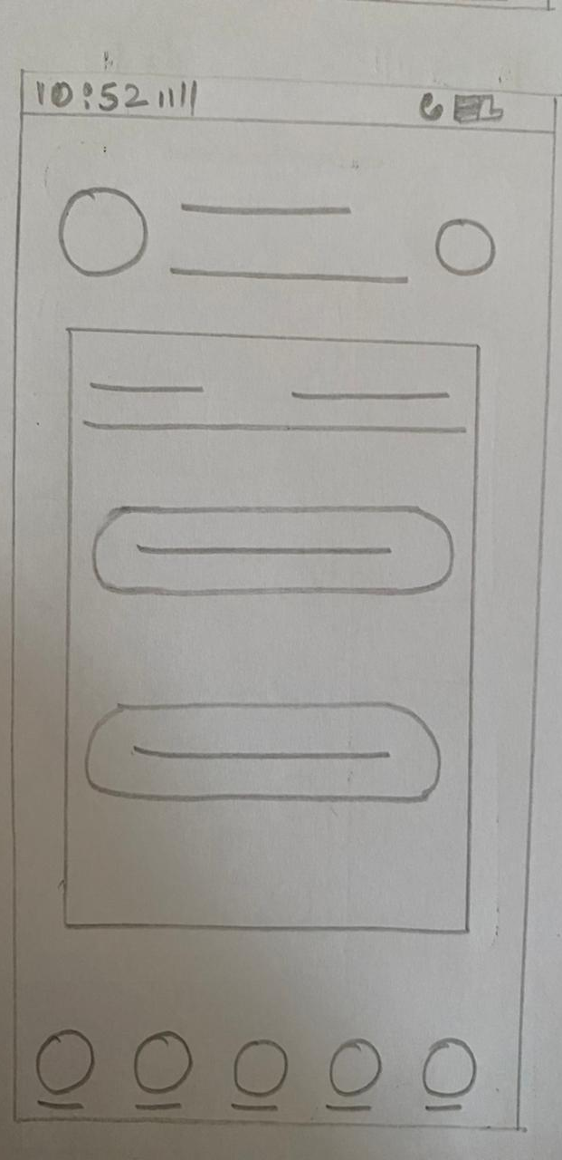
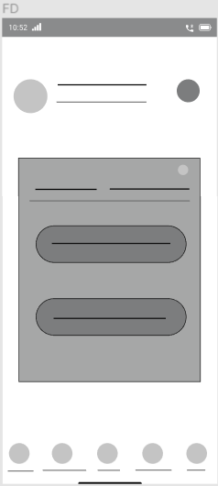
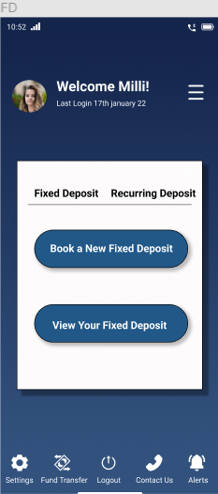
SCREEN 8

Slide 26
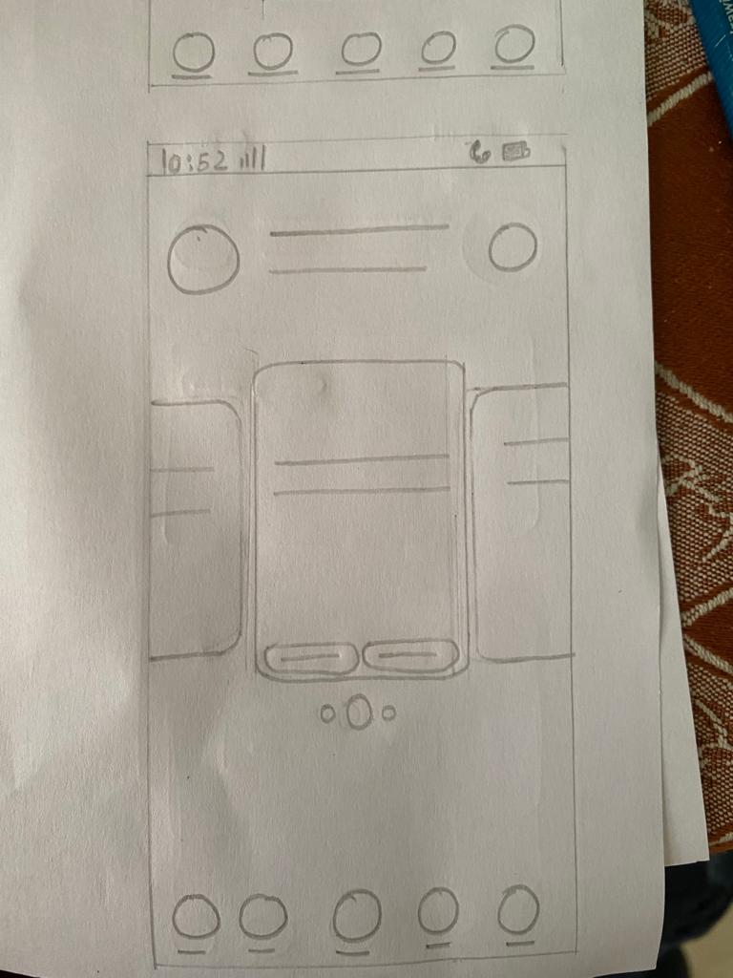
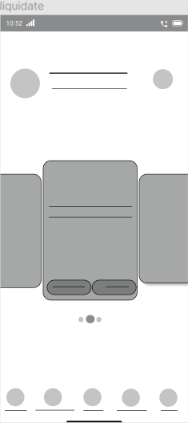
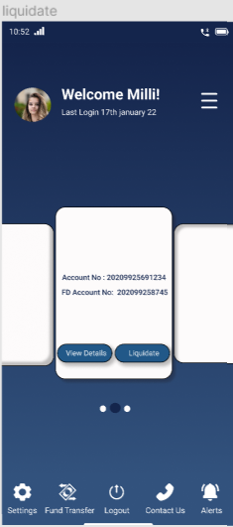
SCREEN 9

Slide 27
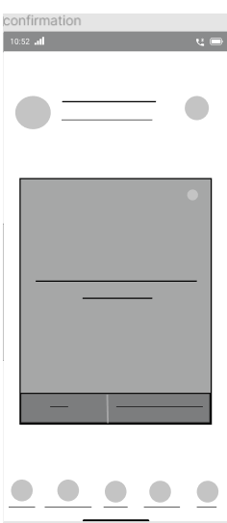
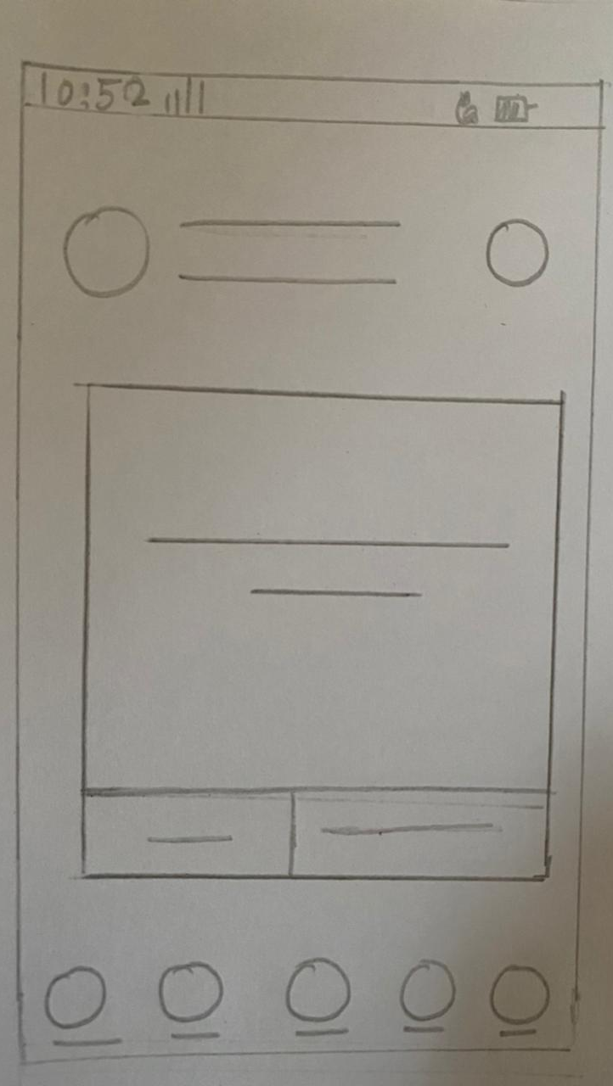
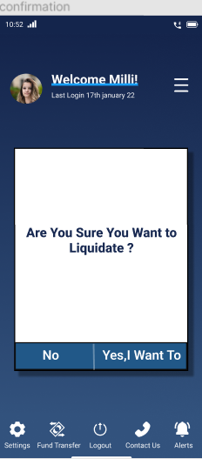
SCREEN 10

Slide 28
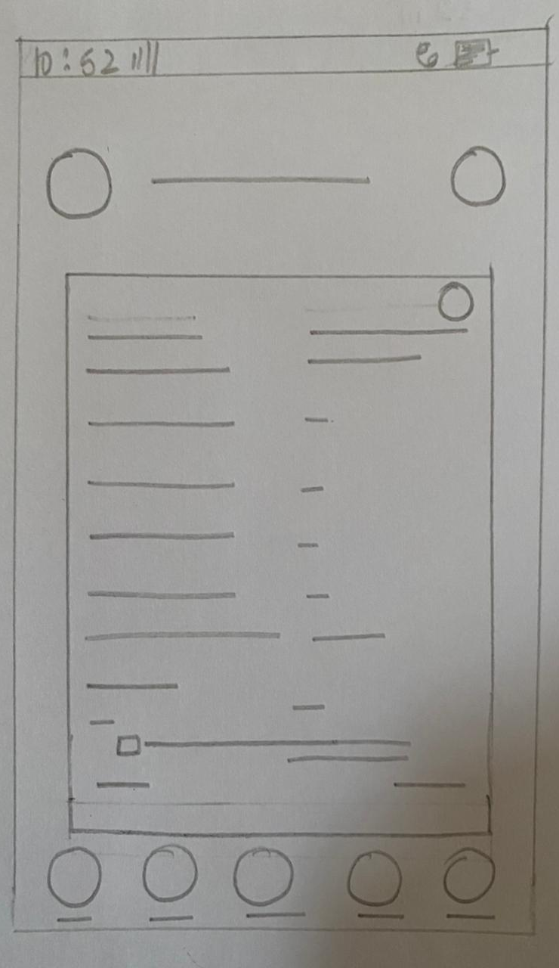
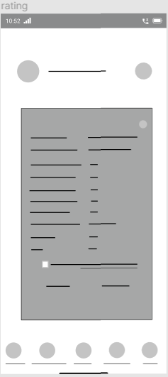
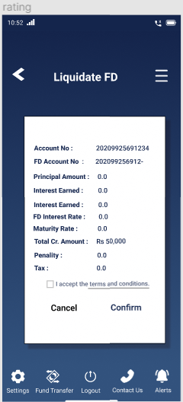
SCREEN 11

Slide 29
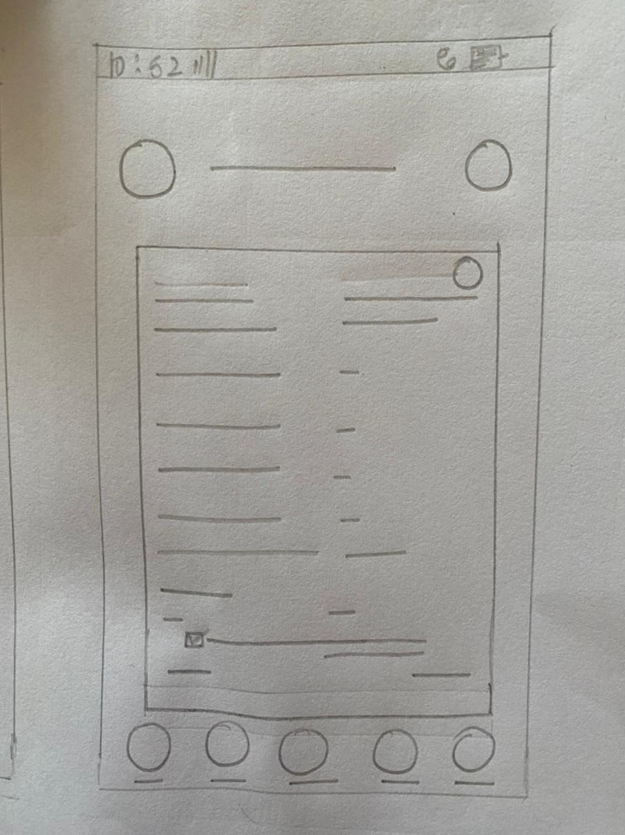
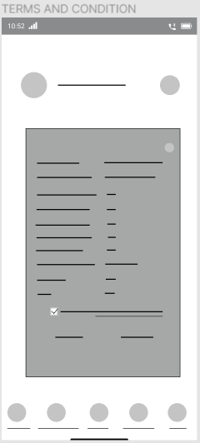
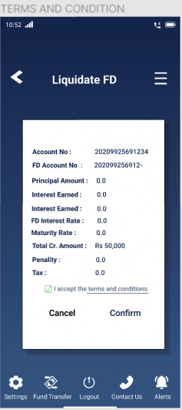
SCREEN 12

Slide 30
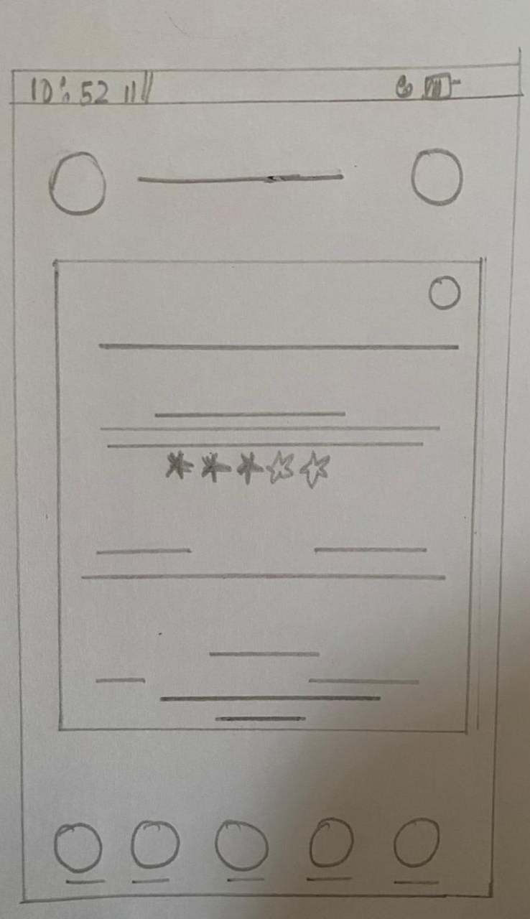
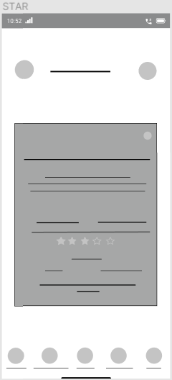
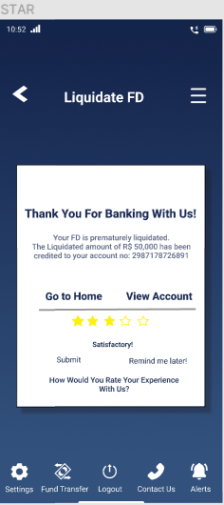
SCREEN 13

Slide 31

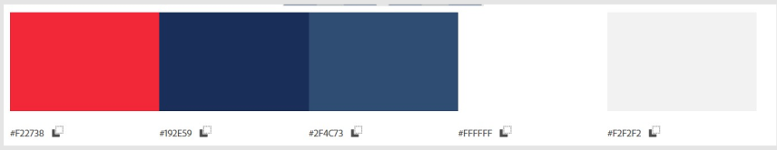

ELEMENT BOARD
Elements
Color Scheme
Typography

Slide 32

MOOD BOARD

Slide 33

CONCLUSION

Slide 34
REFERENCES
https://www.hdfcbank.com/personal/ways-to-bank/mobilebanking/hdfc-bank-mobilebanking-app
https://medium.com/@sancgupta/hdfc-banking-app-the-all-new-mobile-app-redesign-ui-ux-case-study-89bf7f593493
https://www.quora.com/What-are-the-disadvantages-of-HDFC-Bank/answer/Swarna-Kamal-Chandra?ch=15&oid=239633908&share=e9df8041&target_type=answer
http://woikr.com/reviews/icici-hdfc-netbanking-services-a-review-and-comparison/
https://www.hdfcbank.com/personal/resources/learning-centre/digital-banking/top-mobile-banking-technologies
https://v1.hdfcbank.com/assets/pdf/Milestone.pdf
FIGMA PAGE
Wireframes :- https://www.figma.com/file/8m8CiL5gn5cO0Ug7Ubvayw/Untitled?node-id=0%3A1
IA :-https://www.figma.com/file/aycxqdlJjLc5J1gsZaVgeu/Information-architecture-map-(Community)
Prototype :-https://cutt.ly/6IDADM3

Slide 35
THANKYOU!
HERE IS THE WRAP.

